Slide 1
NLH update 03/31/23

Slide 2
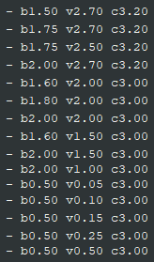
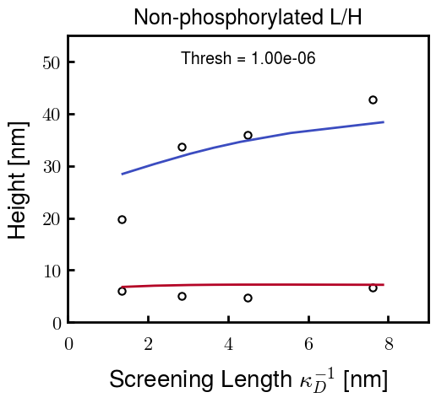


Brute force approach—Pure NFL/NFH
Choose parameters for NFL and NFH independently
NFL Possibilities
NFH Possibilities
For example,
b: Kuhn length
v: Monomer volume
c: Flory Huggins parameter for
most hydrophobic residues

Slide 3
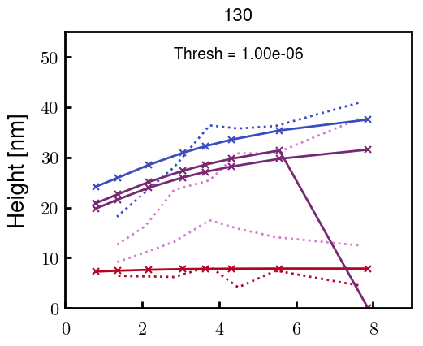
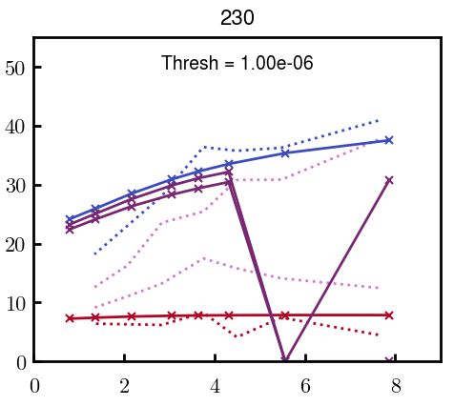
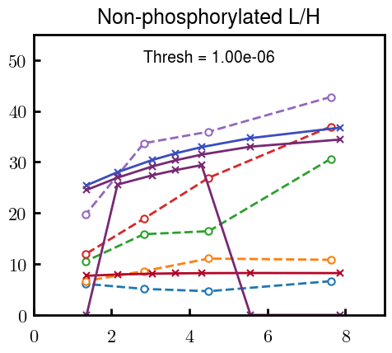
Brute force approach—Blended NFL/NFH
Some examples at L100, L80, L30, L00; ignore points with H = 0
Even with many curves that look good for the pure cases, the height profiles are consistently very non-linear with respect to L composition (from top to bottom)

Slide 4

If height profiles are linear with L, shouldn’t V_L = V_H?
i.e., Replacing a charged L chain with an equal volume of neutral H chain
Can control NFL and NFH volume with both number of Kuhn monomers N_K and volume of Kuhn monomers \nu_K:
For i as L or H,
s

Slide 5
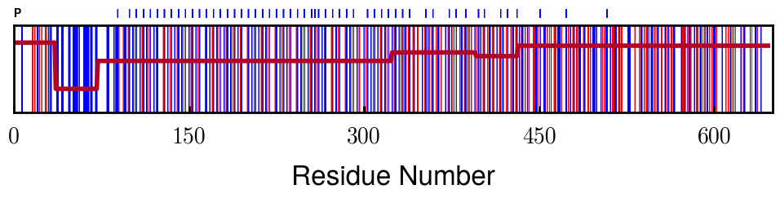
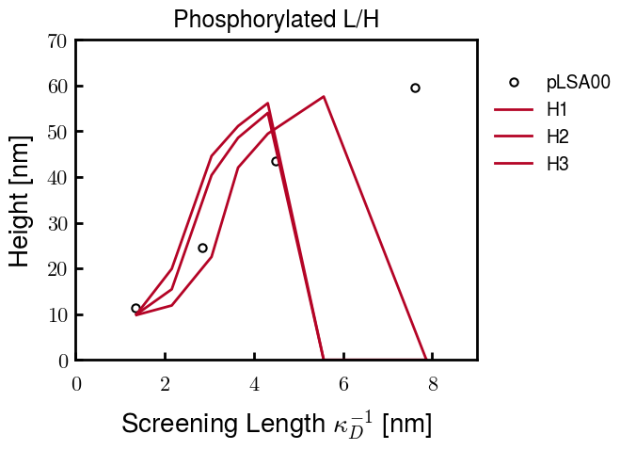
Phosphorylated NFH Progress
phosph. = - 1.5 e
Currently running one more to get a closer fit; if not, the current best one should be close enough
These parameters are close to those of the native NFH. Hopefully means that I can use the final parameters of native NFL to get the blended phosph. results
Trials
Quick note: the points that go to zero just didn’t converge. The point at 6 nm takes a really long time to converge, so I will probably proceed with only calculating from 1 to 6 nm.
In the future, if needed, I can go to 8 nm (1.6 mM)

